Slide 1


Slide 2
Double Question Essays
The Question
IELTS double question essays are also known as ‘direct question’ or ‘two questions’ essays. They are distinguished by two characteristics:
They have one statement with two different questions after it.
The questions may or may not be linked.

Slide 3
Double Question Essays
Fossil fuels are essential for producing electricity, powering industry and fueling transportation. However, one day we will reach a point when all the world’s fossil fuels have been depleted.
How can we conserve these resources?
What are some alternatives to fossil fuels?
Give reasons for your answer and include any relevant examples from your own knowledge or experience.
Write at least 250 words.

Slide 4
Answer
The world is currently reliant on oil, coal and natural gas for the majority of its energy requirements but there will come a time when these run out. This essay will discuss how we can help to prevent our non-renewable resources from becoming depleted by using our cars less frequently and it will name some natural forces that can be harnessed to generate power.
Conserving energy is a responsibility of every individual and an important way in which we can all do our bit is to use more energy-efficient means of transport. The easiest way to do this is to leave the car at home and walk or cycle to our destination if it is not too far away, or take public transport for longer journeys. Another way to reduce our fuel consumption is to car share. Whenever my friends and I get together for coffee, we agree to meet up at a café that we can each get to without having to drive our cars there. We usually go on foot or ride our bikes. If everyone made small decisions like this, it would make a real difference.
The most sustainable alternatives to fossil fuels are the generation of power from natural forces such as the sun, wind and oceans. Solar and wind power are already widely used across the world but it is wave power and tidal energy that have the greatest untapped potential to provide for our energy needs in the future. A report recently commissioned in the United Kingdom estimates that tidal energy could meet as much as 20% of the UK’s current electricity demands once the technology being developed is operational. Wave energy converters are expected to prove equally successful in the long-term.
In conclusion, our Earth’s reserves of fossil fuels will not last forever and we need to continuously develop new technologies to enable us to produce energy from renewable sources such as the sun, wind and water. In the meantime, we can help to slow the rate of depletion by leaving our car at home and using more energy-efficient forms of transport whenever possible.
(351 words)

Slide 5
BREAKDOWN AND EXPLANATION

Slide 6
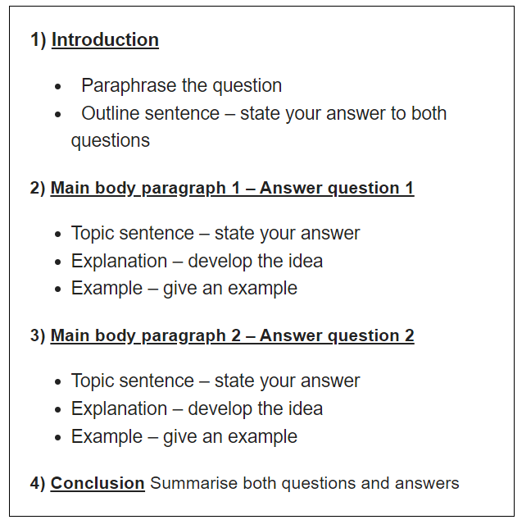
Double Question Essays

Slide 7
Double Question Essays
Keywords
Fossil fuels are essential for producing electricity, powering industry and fueling transportation. However, one day we will reach a point when all the world’s fossil fuels have been depleted.
How can we conserve these resources?
What are some alternatives to fossil fuels?

Slide 8
Introduction
A good introduction has a simple 3 part structure:
1) Paraphrased question
2) Outline sentence – state your answer to both questions
An introduction should:
Have 2-3 sentences
Be 40-60 words long
Take 5 minutes to write

Slide 9
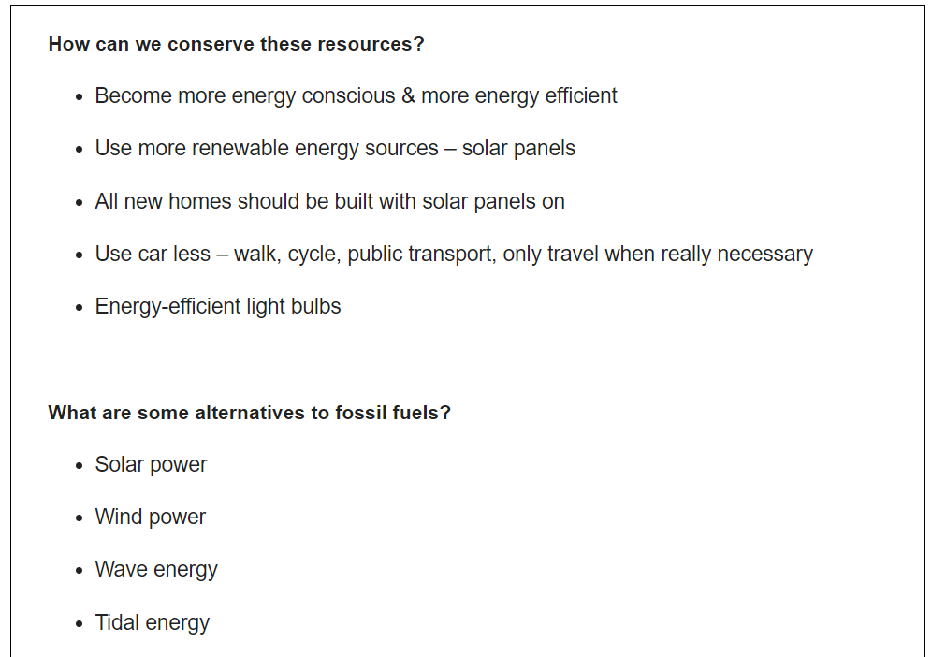
Ideas

Slide 10
Introduction
Question: Fossil fuels are essential for producing electricity, powering industry and fueling transportation. However, one day we will reach a point when all the world’s fossil fuels have been depleted.
How can we conserve these resources?
What are some alternatives to fossil fuels?
Paraphrased question:
The world is currently reliant on oil, coal and natural gas for the majority of its energy requirements but there will come a time when these run out.
Outline statement:
This essay will discuss how we can help to prevent our non-renewable resources from becoming depleted by using our cars less frequently and it will name some natural forces that can be harnessed to generate power.
How can we conserve these resources?
Use car less – walk, cycle, public transport
What are some alternatives to fossil fuels?
Natural forces –solar & wind power, wave & tidal energy
*deplete-use up
*harness-use
DO NOT GIVE ANY HEADING
THE HEADINGS OF THE PARAGRAPHS ARE FOR EXPLANATION ONLY
YOUR WRITING SHOULD ONLY HAVE PARAGRAPHS AS SHOWN IN THE LAST SLIDE

Slide 11
Question: Fossil fuels are essential for producing electricity, powering industry and fueling transportation. However, one day we will reach a point when all the world’s fossil fuels have been depleted.
How can we conserve these resources?
What are some alternatives to fossil fuels?
Introduction:
The world is currently reliant on oil, coal and natural gas for the majority of its energy requirements but there will come a time when these run out. This essay will discuss how we can help to prevent our non-renewable resources from becoming depleted by using our cars less frequently and it will name some natural forces that can be harnessed to generate power.
DO NOT GIVE ANY HEADING
THE HEADINGS OF THE PARAGRAPHS ARE FOR EXPLANATION ONLY
YOUR WRITING SHOULD ONLY HAVE PARAGRAPHS AS SHOWN IN THE LAST SLIDE

Slide 12
How To Write Main Body Paragraphs
Topic sentence
Explanation
Example

Slide 13
Main Body Paragraph 1: Use car less – walk, cycle, public transport, only travel when really necessary
Topic sentence:
Conserving energy is a responsibility of every individual and an important way in which we can all do our bit is to use more energy-efficient means of transport.
Explanation sentence:
The easiest way to do this is to leave the car at home and walk or cycle to our destination if it is not too far away, or take public transport for longer journeys. Another way to reduce our fuel consumption is to car share.
Example sentence:
Whenever my friends and I get together for coffee, we agree to meet up at a café that we can each get to without having to drive our cars there. We usually go on foot or ride our bikes. If everyone made small decisions like this, it would make a real difference.
DO NOT GIVE ANY HEADING
THE HEADINGS OF THE PARAGRAPHS ARE FOR EXPLANATION ONLY
YOUR WRITING SHOULD ONLY HAVE PARAGRAPHS AS SHOWN IN THE LAST SLIDE

Slide 14
Finished Paragraph 1
Conserving energy is a responsibility of every individual and an important way in which we can all do our bit is to use more energy-efficient means of transport. The easiest way to do this is to leave the car at home and walk or cycle to our destination if it is not too far away, or take public transport for longer journeys. Another way to reduce our fuel consumption is to car share. Whenever my friends and I get together for coffee, we agree to meet up at a café that we can each get to without having to drive our cars there. We usually go on foot or ride our bikes. If everyone made small decisions like this, it would make a real difference.
DO NOT GIVE ANY HEADING
THE HEADINGS OF THE PARAGRAPHS ARE FOR EXPLANATION ONLY
YOUR WRITING SHOULD ONLY HAVE PARAGRAPHS AS SHOWN IN THE LAST SLIDE

Slide 15
Main Body Paragraph 2: Renewable energy / natural forces – solar & wind power, wave & tidal energy
Topic sentence:
The most sustainable alternatives to fossil fuels are the generation of power from natural forces such as the sun, wind and oceans.
Explanation sentence:
Solar and wind power are already widely used across the world but it is wave power and tidal energy that have the greatest untapped potential to provide for our energy needs in the future.
Example sentence:
A report recently commissioned in the United Kingdom estimates that tidal energy could meet as much as 20% of the UK’s current electricity demands once the technology being developed is operational. Wave energy converters are expected to prove equally successful in the long-term.
*untapped-not used yet
DO NOT GIVE ANY HEADING
THE HEADINGS OF THE PARAGRAPHS ARE FOR EXPLANATION ONLY
YOUR WRITING SHOULD ONLY HAVE PARAGRAPHS AS SHOWN IN THE LAST SLIDE

Slide 16
Finished Paragraph 2
The most sustainable alternatives to fossil fuels are the generation of power from natural forces such as the sun, wind and oceans. Solar and wind power are already widely used across the world but it is wave power and tidal energy that have the greatest untapped potential to provide for our energy needs in the future. A report recently commissioned in the United Kingdom estimates that tidal energy could meet as much as 20% of the UK’s current electricity demands once the technology being developed is operational. Wave energy converters are expected to prove equally successful in the long-term.
DO NOT GIVE ANY HEADING
THE HEADINGS OF THE PARAGRAPHS ARE FOR EXPLANATION ONLY
YOUR WRITING SHOULD ONLY HAVE PARAGRAPHS AS SHOWN IN THE LAST SLIDE

Slide 17
Conclusion
You can start almost any final paragraph of an IELTS essay with the words:
In conclusion
or
To conclude
To create a great conclusion, you simply have to paraphrase the introduction

Slide 18
Question: Fossil fuels are essential for producing electricity, powering industry and fueling transportation. However, one day we will reach a point when all the world’s fossil fuels have been depleted.
How can we conserve these resources?
What are some alternatives to fossil fuels?
Introduction:
The world is currently reliant on oil, coal and natural gas for the majority of its energy requirements but there will come a time when these run out. This essay will discuss how we can help to prevent our non-renewable resources from becoming depleted by using our cars less frequently and it will name some natural forces that can be harnessed to generate power.
Conclusion
In conclusion, our Earth’s reserves of fossil fuels will not last forever and we need to continuously develop new technologies to enable us to produce energy from renewable sources such as the sun, wind and water. In the meantime, we can help to slow the rate of depletion by leaving our car at home and using more energy-efficient forms of transport whenever possible.
DO NOT GIVE ANY HEADING
THE HEADINGS OF THE PARAGRAPHS ARE FOR EXPLANATION ONLY
YOUR WRITING SHOULD ONLY HAVE PARAGRAPHS AS SHOWN IN THE LAST SLIDE

Slide 19
Answer
The world is currently reliant on oil, coal and natural gas for the majority of its energy requirements but there will come a time when these run out. This essay will discuss how we can help to prevent our non-renewable resources from becoming depleted by using our cars less frequently and it will name some natural forces that can be harnessed to generate power.
Conserving energy is a responsibility of every individual and an important way in which we can all do our bit is to use more energy-efficient means of transport. The easiest way to do this is to leave the car at home and walk or cycle to our destination if it is not too far away, or take public transport for longer journeys. Another way to reduce our fuel consumption is to car share. Whenever my friends and I get together for coffee, we agree to meet up at a café that we can each get to without having to drive our cars there. We usually go on foot or ride our bikes. If everyone made small decisions like this, it would make a real difference.
The most sustainable alternatives to fossil fuels are the generation of power from natural forces such as the sun, wind and oceans. Solar and wind power are already widely used across the world but it is wave power and tidal energy that have the greatest untapped potential to provide for our energy needs in the future. A report recently commissioned in the United Kingdom estimates that tidal energy could meet as much as 20% of the UK’s current electricity demands once the technology being developed is operational. Wave energy converters are expected to prove equally successful in the long-term.
In conclusion, our Earth’s reserves of fossil fuels will not last forever and we need to continuously develop new technologies to enable us to produce energy from renewable sources such as the sun, wind and water. In the meantime, we can help to slow the rate of depletion by leaving our car at home and using more energy-efficient forms of transport whenever possible.
(351 words)

